Slide 1




Story – The Beginning
VS

Slide 2
Story – The END
VS

Slide 3
Features
Local multiplayer
Computer opponent
Wind resistance
Save 1 game at a time
4 different maps
Physical properties
Shop available every turn
Descriptive HUD
Money system
Local Leaderboard

Slide 4

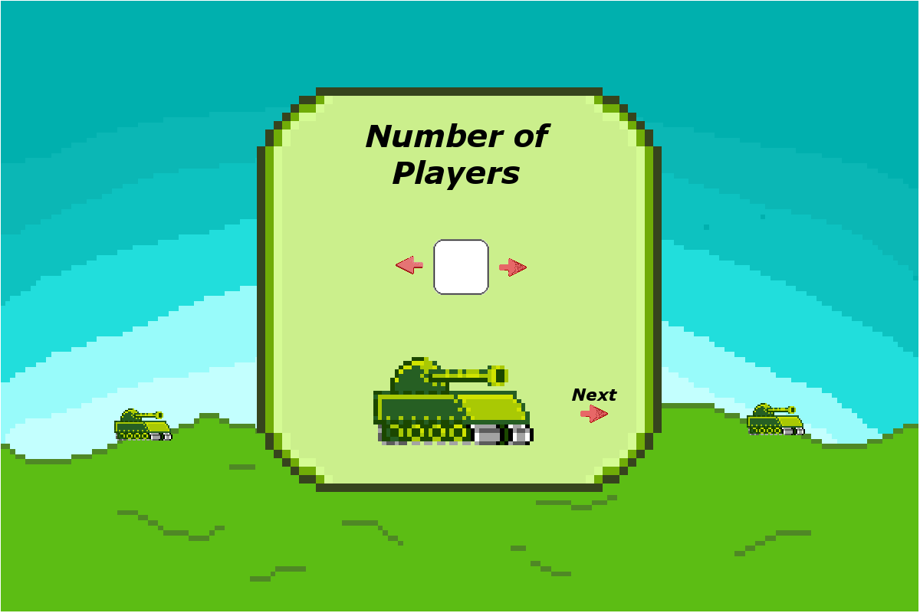
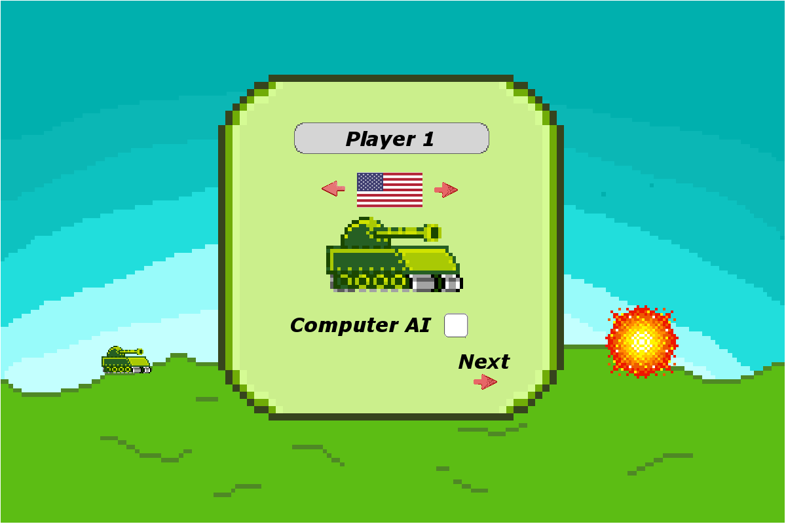

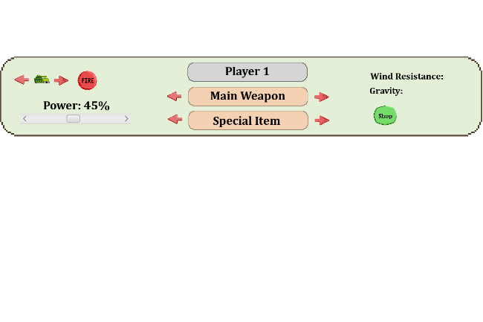
GUI

Slide 5




TANKS
China
Canada
USA
North Korea

Slide 6















Items
Repair
Laser
Shrapnel
Atomic
Armor
HMG
LMG
Airstrike
Engine
Missile
Mine
Precision Strike
Teleport
RC-C4
Shield

Slide 7

Physics Algorithm & Efficiency
Distance: $d= \frac{vcosθ}{g}\left(vsinθ+ \sqrt{{\left(vsinθ\right)}^{2}+2gy_{i}}\right)$
O(1)
Travel Time: $t= \frac{d}{v\cos{θ}}$
O(1)
$Y Position: y= y_{i}+x\tan{θ}− \frac{gx^{2}}{2{(v\cos{θ})}^{2}}$
O(n)
X Position: $x= x_{i}+v\cos{θ∗t}$
O(n)

Slide 8
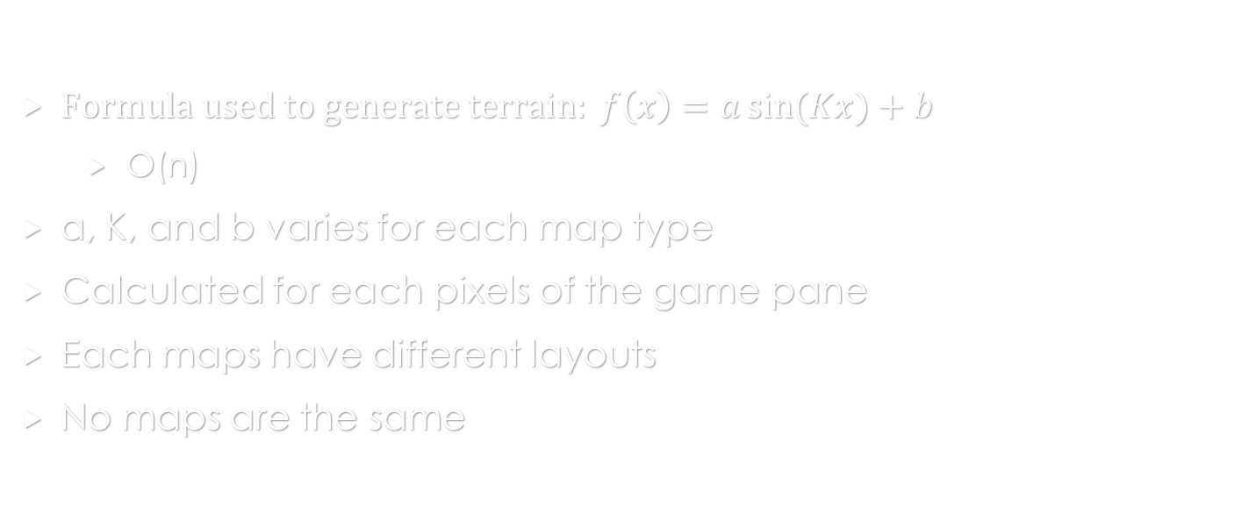
Map Generation Algorithm & Efficiency
$Formula used to generate terrain: f\left(x\right)=a\sin{(Kx)}+b$
O(n)
a, K, and b varies for each map type
Calculated for each pixels of the game pane
Each maps have different layouts
No maps are the same

Slide 9
Save/Load Game & LeaDERBOARD
Game can be saved after every turn in game
Game can be load from the main menu
Player, Tanks, MapGeneration, & TanksGame are stored in a binary file
Leaderboard is accessed in the main menu
Leaderboard is save in txt file

Slide 10
Game Mechanics
Last player to stand wins
Player must destroy other tanks with weapons
Turn based
Limited actions each turn
Fixed amount of money given each turn
Completing certain actions rewards money
Player score is affected by the number of turns to win, the amount of money spent, & the number of HP left
Each type of weapons have unique properties

Slide 11
Multiplayer
Support for up to 4 players
Each player controls a different tank
Multiplayer functions are on the same computer

Slide 12
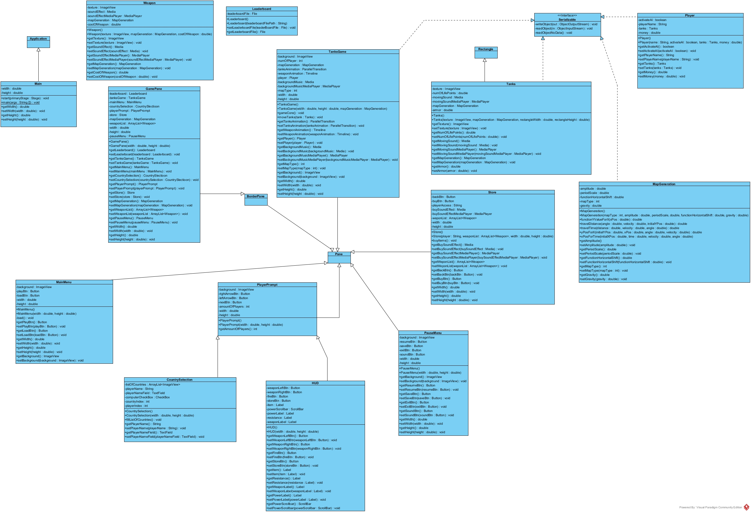

Slide 13
Roadmap
Design: February 26
UI: March 11
Map Generation: March 11
HUD: March 18
Tanks: March 18
Weapons: March 25
Save / Load: April 4
Leaderboard: April 11
Sound: April 15
Physics: April 24
Game Mechanics: April 27
AI: April 30
Bug Testing & Final Version: May 4

